Slide 1


Unit-01 Basics of HTML and CSS
Internet Programming (IP)
Admas Abtew
Faculty of Computing and Informatics
Admas.abtew@ju.edu.et
0912499102

Slide 2

Outline HTML
Introduction to HTML
What is a Web Page?
My First HTML Page
HTML Code Formatting
Basic HTML Tags
Heading
Paragraph
Color
Font
List
Anchor
Image
HTML Tables
HTML Forms
HTML Meta tags
Media tags
HTML 5 tags and validation
Outline CSS
What is CSS?
Syntax and structure of CSS
CSS rules for Backgrounds, Colors and properties
Manipulating texts, Fonts
The Box Model
borders and boxes
Margins and Padding
Lists
CSS Positioning and Float Property
Animations
Tooltip
Style images
Variables
Media Queries
Wildcard Selectors (*, ^ and $) in CSS
Working with Gradients, Pseudo Class
Pseudo elements
basic of frameworks like Bootstrap
Looping

Slide 3
What is a Web Page?
A webpage is a document, commonly written in HTML, that is viewed in an Internet browser.
HTML – Hyper Text Markup Language is the notation for describing
document structure (semantic markup)
formatting (presentation markup)
A web page can be accessed by entering a URL into a browser's address bar.
A web page may contain text, graphics, and hyperlinks to other web pages and files.
The first web page was created at CERN by Tim Berners-Lee on August 6, 1991.
You can visit and browse the first website and the first web page at the info.cern.ch address.

Slide 4
Creating HTML Pages
An HTML file must have an .htm or .html file extension
HTML files can be created with text editors:
NotePad, NotePad ++, PSPad
Or HTML editors (WYSIWYG Editors):
Microsoft FrontPage
Macromedia Dreamweaver
Netscape Composer
Visual Studio
Open any above mentioned editors and create a new file with .html extension and save the file.
After saving the file you can open the file with any Web Browser in order to view the output.

Slide 5
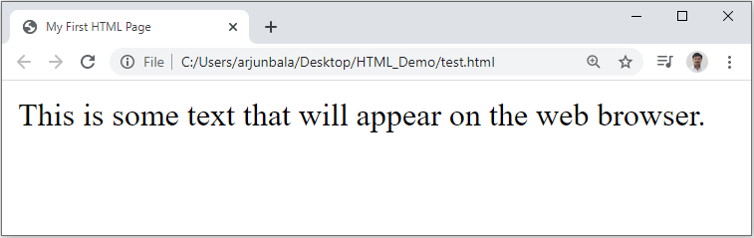
First HTML Page
test.html
<!DOCTYPE HTML>
<html>
<head>
<title>My First HTML Page</title>
</head>
<body>
<p>This is some text...</p>
</body>
</html>

Slide 6
HTML Structure
HTML is comprised of “elements” and “tags”
Begins with <html> and ends with </html>
Elements (tags) are nested one inside another:
Tags have attributes:
HTML describes structure using two main sections: <head> and <body>
The HTML source code should be formatted to increase readability and facilitate debugging.
Every block element should start on a new line.
Every nested (block) element should be indented.
Browsers ignore multiple whitespaces in the page source, so formatting is harmless.
For performance reasons, formatting can be sacrificed
<html> <head></head> <body></body> </html>
<img src="logo.jpg" alt="logo" />

Slide 7
First HTML Page
HTML header
<!DOCTYPE HTML>
<html>
<head>
<title>My First HTML Page</title>
</head>
<body>
<p>This is some text...</p>
</body>
</html>
Opening tag
Closing tag
HTML body

Slide 8
Basic HTML Tags
Headings
Paragraph
Colors
Fonts
List
Anchor Tag
Image
Table
Form

Slide 9
1) Headings
Headings are important because search engines use the headings to index the structure and content of your web pages.
<h1> text </h1> -- largest of the six
<h2> text </h2>
<h3> text </h3>
<h4> text </h4>
<h5> text </h5>
<h6> text </h6> -- smallest of the six
align="position" --left (default), center or right

Slide 10
2) <p> Paragraph
The HTML <p> element represents a paragraph.
Paragraphs are usually represented in visual media as blocks of text separated from adjacent blocks by blank lines and/or first-line indentation, but HTML paragraphs can be any structural grouping of related content, such as images or form fields.
Paragraphs are block-level elements, and notably will automatically close if another block-level element is parsed before the closing </p> tag.
We can use align attribute of the paragraph tag to specify the text alignment for the text inside the paragraph, ex. <p align=“center”>our test</p>

Slide 11
3) Colors
We can use color values for mainly two attributes named bgcolor and color.
Possible values for the color are,
many are predefined (red, blue, green, ...)
all colors can be specified as a six character hexadecimal value: #RRGGBB
#FF0000 – red
#888888 – gray
#00FF00 –green
#000000 – black
For example, <body bgcolor=“red”> or <body bgcolor=“#888888”>

Slide 12
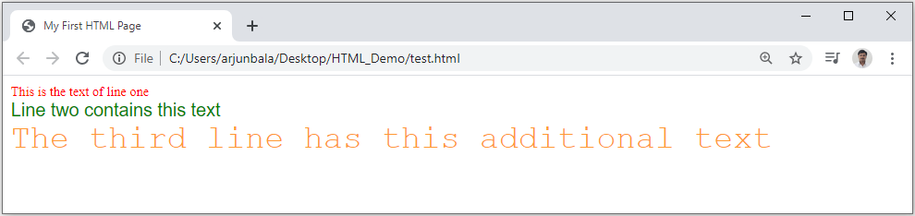
4) Fonts
The <font> tag specifies the font face, font size, and color of text.
The <font> tag is not supported in HTML5.
<font color="red" size="2" face="Times Roman">
This is the text of line one
</font>
<br/>
<font color="green" size="4" face="Arial">
Line two contains this text
</font>
<br/>
<font color="#FF9933" size="6" face="Courier">
The third line has this additional text
</font>

Slide 13
5) List
Ordered List
Block-A
Block-B
Block-C
Block-D
Unordered List
Block-A
Block-B
Block-C
Block-D
Block-A
Block-B
Block-C
Block-D
Block-A
Block-B
Block-C
Block-D
Block-A
Block-B
Block-C
Block-D
Block-A
Block-B
Block-C
Block-D
Block-A
Block-B
Block-C
Block-D
Block-A
Block-B
Block-C
Block-D

Slide 14
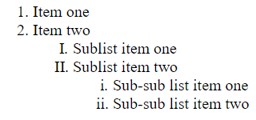
5.1) Ordered List (OL)
<ol>
<li> Item one </li>
<li> Item two </li>
<ol type="I">
<li> Sublist item one </li>
<li> Sublist item two </li>
<ol type="i">
<li> Sub-sub list item one </li>
<li> Sub-sub list item two </li>
</ol>
</ol>
</ol>
Types:
Type = 1 (default)
Type = a
Type = A
Type = I
Type = i
Output

Slide 15
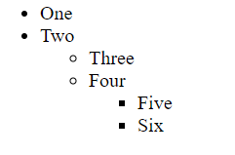
5.2) Unordered List (UL)
<ul>
<li> One </li>
<li> Two </li>
<ul type="circle">
<li> Three </li>
<li> Four </li>
<ul type="square">
<li> Five </li>
<li> Six </li>
</ul>
</ul>
</ul>
Types:
Type = disc (default)
Type = circle
Type = square
Output

Slide 16
6) <a> Anchor Tag (Hyperlinks)
The <a> tag defines a hyperlink, which is used to link from one page to another.
An Anchor tag have 3 important attributes:
the href attribute (hypertext reference) defines the target address of the document.
the name attribute of the anchor tag can be used to enable users to “jump” to a specific point on a page.
the target attribute specifies how the destination page or the target document should be opened. target="_ blank" is used for opening of the target page in a new tab.
Link to an absolute URL:
Example, <a href="http://www.darshan.ac.in"> Darshan </a>.
Link to a relative URL:
Example, <a href=“./index.php"> Home </a>.
Link to a section within a URL:
Example, <a href=“#reference"> Reference Section. </a>.

Slide 17
7) Images
The HTML <img> element embeds an image into the document.
Syntax: <img src= "pathToImage" />
Attributes:
the src attribute is required, and contains the path to the image we want to embed.
the alt attribute holds a text description of the image, which isn't mandatory but is incredibly useful for accessibility (screen readers read this description out to their users so they know what the image means). Alt text is also displayed on the page if the image can't be loaded for some reason: for example, network errors, content blocking etc…
the width & height attribute can be in units of pixels or percentage of page or frame.
the align attribute (currently deprecated) will aligns the image with its surrounding context (Use the float and/or vertical-align CSS properties instead of this attribute).

Slide 18
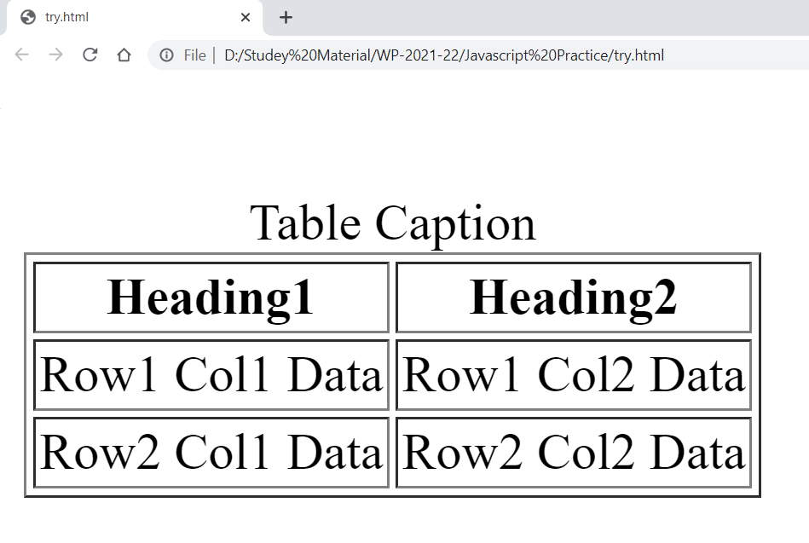
8) Table
<table border=1>
<caption>Table Caption</caption>
<tr>
<th>Heading1</th>
<th>Heading2</th>
</tr>
<tr>
<td>Row1 Col1 Data</td>
<td>Row1 Col2 Data</td>
</tr>
<tr>
<td>Row2 Col1 Data</td>
<td>Row2 Col2 Data</td>
</tr>
</table>
<table> table tag
<caption> optional table title
<tr> table row
<th> table header
<td> table data element
Output

Slide 19
HTML Forms
HTML forms are used to create GUIs on Web pages
Usually the purpose is to ask the user for information
The information is then sent back to the server
A form is an area that can contain form elements
The syntax is: <form parameters> ...form elements... </form>
Form elements include: buttons, checkboxes, text fields, radio buttons, drop-down menus, etc
Other kinds of HTML tags can be mixed in with the form elements
A form usually contains a Submit button to send the information in the form elements to the server
The form’s parameters tell browser how to send the information to the server (there are two different ways it could be sent)

Slide 20
The <form> Tag
The <form parameters> ... </form> tag encloses form elements (and probably other HTML as well)
The parameters to form tell what to do with the user input
action="url" (required)
Specifies where to send the data when the Submit button is clicked
method="get" (default)
Form data is sent as a URL with ?form_data info appended to the end
Can be used only if data is all ASCII and not more than 100 characters
method="post"
Form data is sent in the body of the URL request
Cannot be bookmarked by most browsers
target="target"
Tells where to open the page sent as a result of the request
target= _blank means open in a new window
target= _top means use the same window

Slide 21
Form Elements
Input
Select
Textarea
Button
Label
Fieldset
Legend
Etc…
Input Types (HTML4)
text
password
checkbox
radio
submit
button
reset
file
Input Types (HTML5)
number
email
search
url
tel
range
color
date
time
datetime-local
month
week

Slide 22
HTML5 Form Validation
Form validation is a “technical process where a web-form checks if the information provided by a user is correct.”
The form will either alert the user that something is not in correct format and need to fix to proceed, or the form will be validated and the user will be able to continue with their process.
Form can be validated both in Client-Side as well as Server-Side, it is recommended to validate the form in both the side.
Form validation generally performs two functions.
Basic Validation
Emptiness
Length Validation etc……
Data Format Validation
Secondly, the data that is entered must be checked for correct form and value.
Email Validation
Mobile Number Validation
Enrollment Number Validation etc….

Slide 23
HTML5 Form Validation (Cont…)
We can use required attribute in order to stop user sending empty data to server.
We can use pattern attribute in order to force some format on user before sending the data to server.
We can use title attribute for custom error message.
1
<input type="text" name="txtName" required/>
1
<input type="text" name="txtName" pattern="[0-9]{10}"/>
1
<input type="text" name="txtName"
pattern="[0-9]{10}"
title="Please enter 10 digit mobile number"
required/>

Slide 24
META Tag
Metadata is data (information) about data.
The <meta> tag provides metadata about the HTML document.
Metadata will not be displayed on the page.
Meta elements are typically used to specify page description, keywords, author of the document, last modified and other metadata.
The metadata can be used by search engines (keywords), browsers (how to display content or reload page) or other web services.

Slide 25
Meta Tag Attributes
Attribute | Value | Description
charset | character_set | Specifies the character encoding for the HTML document
name | author description keywords robots expires | Specifies a name for the metadata
http-equiv | content-type default-style refresh | Provides an HTTP header for the information/value of the content attribute
content | text | Gives the value associated with the http-equiv or name attribute
scheme | format/URI USA/Europe | Not supported in HTML5. Specifies a scheme to be used to interpret the value of the content attribute

Slide 26
Media Tags
Video tag
Audio tag

Slide 27
Video Tag
The HTML <video> element is used to show a video on a web page.
The controls attribute adds video controls, like play, pause, and volume.
The width and height attributes are used to set width and height respectively.
The autoplay attribute start a video automatically.
The muted attribute will mute your video sound.
The <source> element allows you to specify alternative video files in src attribute which the browser may choose from. The browser will use the first recognized format.
The text written in between the <video> and </video> tags will display only if browser do not support the <video> element.
1
<video width="300" height="200" autoplay muted> <source src=“video.mp4" type="video/mp4"> <source src=“video.ogg" type="video/ogg"> The video tag is not supported in your browser. </video>

Slide 28
Audio Tag
The HTML <audio> element is used to play an audio file on a web page.
The controls attribute adds audio controls, like play, pause, and volume.
The autoplay attribute start a audio automatically.
The muted attribute will mute your audio sound.
The <source> element allows you to specify alternative audio files in src attribute which the browser may choose from. The browser will use the first recognized format.
The text written in between the <audio> and </audio> tags will display only if browser do not support the <audio> element.
1
<audio controls autoplay muted> <source src=“myaudio.ogg" type="audio/ogg"> <source src=“myaudio.mp3" type="audio/mpeg"> The audio tag is not supported in your browser. </audio>

Slide 29
What is CSS?
Cascading Style Sheets, fondly referred to as CSS, is a simple design language intended to simplify the process of making web pages presentable.
CSS defines layout of HTML documents. For example, CSS covers Fonts, colors, margins, lines, height, width, background images, advanced positions and many other things.
Importance of CSS :
CSS defines HOW HTML elements are to be displayed.
Styles are normally saved in external .css files.
External style sheets enable you to change the appearance and layout of all the pages in a Web site, just by editing one single file.
Advantages :
Improves Website Presentation
External CSS makes Updates Easier and Smoother
External CSS helps Web Pages Load Faster
Disadvantages :
Browser Dependent
Difficult to retrofit in old websites

Slide 30
Basic Syntax of CSS
A CSS rule has two main parts: a selector, and one or more declarations
The selector can be HTML element, id or class.
Each declaration consists of a property and a value.
The property is the style attribute you want to change. Each property has a value.
Selector
Declaration 1
Declaration 2
h1
{color:blue; font-size: 12px;}
property
value
property
value

Slide 31
The “id” selector
The id selector is used to specify a style for a single, unique element.
The id selector uses the id attribute of the HTML element, and is defined with a "#“ in css.
The style rule below will be applied to the element with id="para1":
HTML
<h1 id=“para1”>
Hello Friends
</h1>
<h1>
How are you
</h1>
CSS
#para1{
color: blue;
}
Output
Hello Friends
How are you

Slide 32
The “class” selector
The class selector is used to specify a style for a group of elements.
The class selector uses the HTML class attribute, and is defined with a ".“ in css.
HTML
<h1 class=“myClass”>
Hello Friends
</h1>
<h1>
How are you
</h1>
<h1 class=“myClass”>
How are you
</h1>
CSS
.myClass{
color: blue;
}
Output
Hello Friends
How are you
How are you

Slide 33
Different ways to write CSS
There are three ways of writing a style sheet:
Inline Style
Internal/Embedded Style sheet
External Style Sheet

Slide 34
1) Inline Style
It is possible to place CSS right in your HTML code, and this method of CSS usage is referred to as inline css.
Inline CSS has the highest priority out of external, internal, and inline CSS.
This means that you can override styles that are defined in external or internal by using inline CSS.
If you want to add a style inside an HTML element all you have to do is specify the desired CSS properties with the style HTML attribute.
Example:
HTML
<p style="background: blue; color: white;"> My Inline CSS </p>

Slide 35
2) Internal Style Sheet
This type of CSS is only for Single Web Page.
When using internal CSS, we must add a new tag, <style>, inside the <head> tag.
The HTML code below contains an example of <style>'s usage.
HTML
<html><head>
<style type="text/css">
p{ color: red;}
</style>
</head><body>
<p>Your page's content!</p></body>
</html>

Slide 36
3) External Style Sheet
When using CSS it is preferable to keep the CSS separate from your HTML.
Placing CSS in a separate file allows the web designer to completely differentiate between content (HTML) and design (CSS).
External CSS is a file that contains only CSS code and is saved with a ".css" file extension.
This CSS file is then referenced in your HTML using the <link> instead of <style>.
Demo.html
<html>
<head>
<link rel=“stylesheet” type=“text/css” href=“test.css”>
</head>
<body>
<p> Hello Friends </p>
<p id=“para1”> How are you? </p>
</body>
</html>
test.css
#para1{
text-align: center;
}
p
{
color : blue;
}
Output
Hello Friends
How are you?

Slide 37
3) External Style Sheet (Cont.)
Advantages:
It keeps your website design and content separate.
It's much easier to reuse your CSS code if you have it in a separate file. Instead of typing the same CSS code on every web page you have, simply have many pages refer to a single CSS file with the "link" tag.
You can make drastic changes to your web pages with just a few changes in a single CSS file.

Slide 38
Assign Multiple Classes
We can apply different class to same html element by giving space separated class names in the class attribute:
Demo.html
<html>
<head>
<link rel=“stylesheet” type=“text/css” href=“test.css”>
</head>
<body>
<h1 class=“class1 class2”>
How are you?
</h1>
</body>
</html>
test.css
. class1
{
color : blue;
}
. class2
{
text-align : center;
}
Output
How are you?

Slide 39
Multiple Selection
We can apply same css to multiple selectors using comma separated selector list, for example :
Demo.html
<html>
<head>
<link rel=“stylesheet” type=“text/css” href=“test.css”>
</head>
<body>
<p> Hello Friends </p>
<h1> How are you? </h1>
</body>
</html>
test.css
p, h1
{
color : blue;
}
Output
Hello Friends
How are you?

Slide 40
Multi-level Selection
We can use hierarchical path to target html element by space separated element/class/id names, for example :
Demo.html
<html>
<head>
<link rel=“stylesheet” type=“text/css” href=“test.css”>
</head>
<body>
<h1>Hello Friends…</h1>
<div>
<h1>How are you?</h1>
</div>
</body>
</html>
test.css
div h1
{
color : blue;
}
Output
Hello Friends…
How are you?

Slide 41
Background Property
Background Color (background-color)
Background Image (background-image)
Background Image Repeat (background-repeat)
Fixed Background Image (background-attachment)
Background Image Positioning (background-position)
Property Name

Slide 42
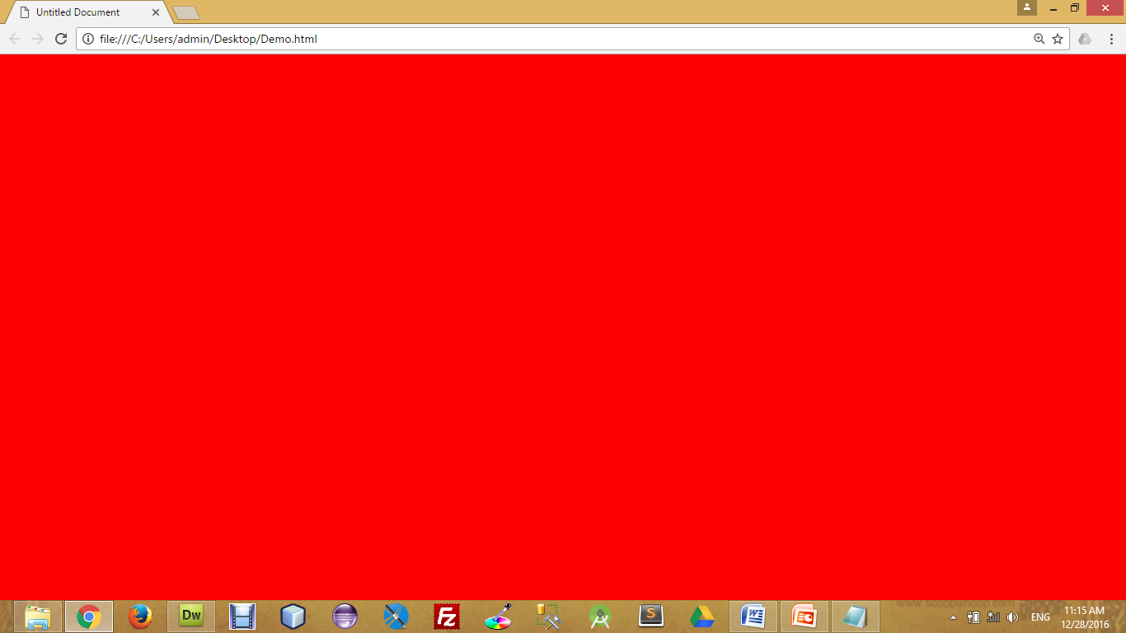
Background Color
The background-color property specifies the background color of an element.
The background color of a page is defined in the body selector:
Below is example of CSS backgrounds
test.css
body
{
background-color : red;
background-color : #FF0000;
background-color : rgb(255,0,0);
}

Slide 43

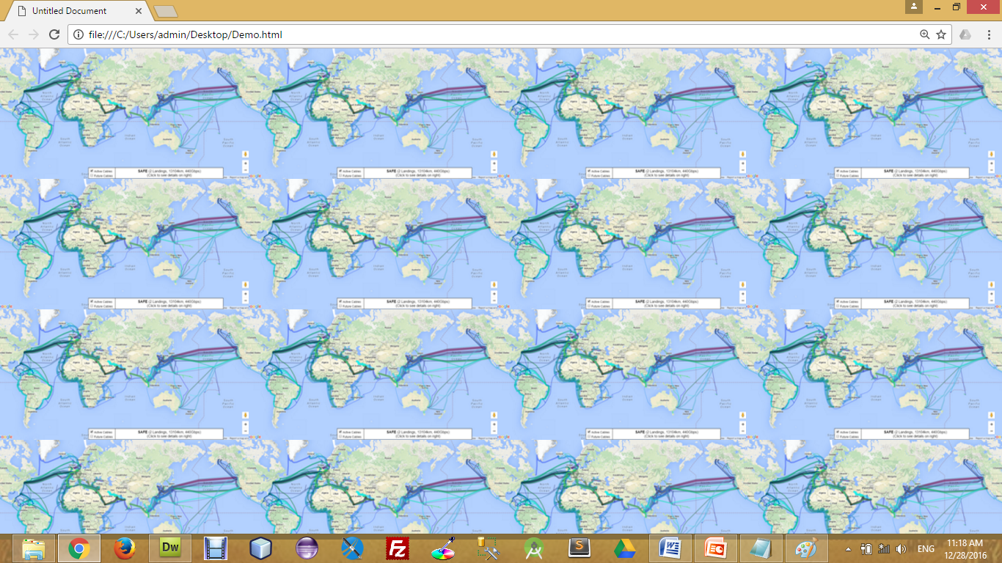
Background Image
The background-image property specifies an image to use as the background of an element.
For Example,
test.css
body
{
background-image : url(‘pathToImage.jpg’);
}

Slide 44
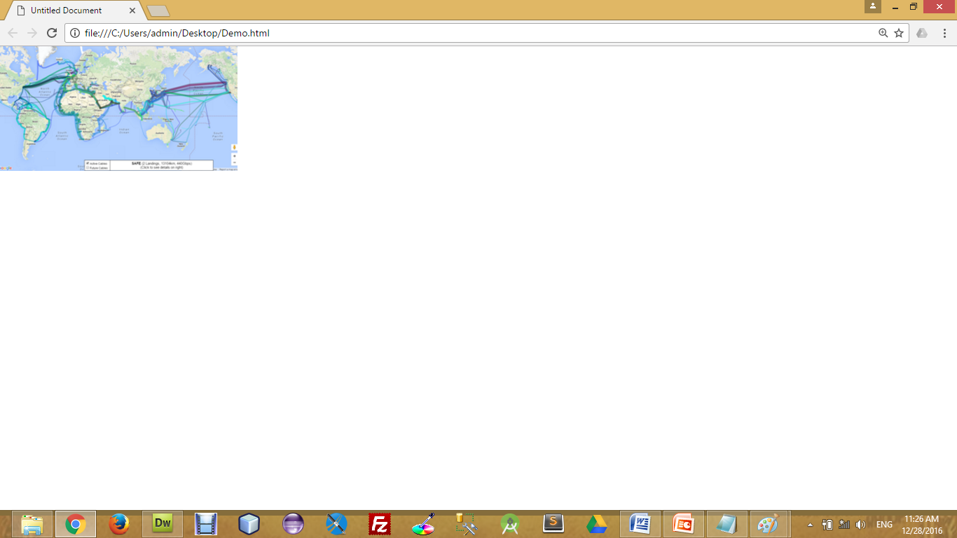
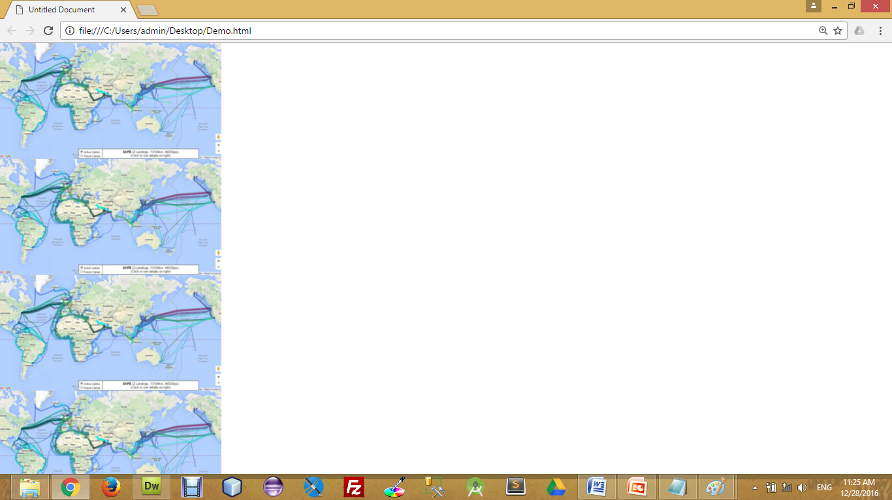
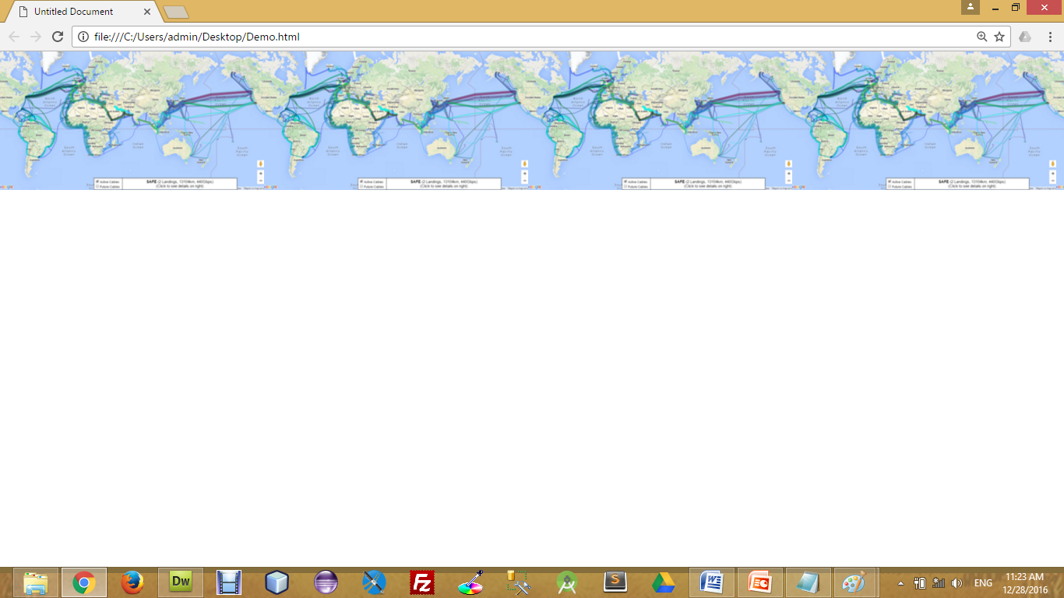
Background Image Repeat
You can have a background image repeat vertically (y-axis), horizontally (x-axis), in both directions, or in neither direction.
test.css
body
{
background-image : url(‘pathToImage.jpg’);
background-repeat : repeat;
background-repeat : repeat-x;
background-repeat : repeat-y;
background-repeat : no-repeat;
}

Slide 45
Fixed Background Image
The background-attachment property sets whether a background image is fixed or scrolls with the rest of the page.
For Example,
test.css
body
{
background-image : url(‘pathToImage.jpg’);
background-repeat : no-repeat;
background-attachment : fixed;
}

Slide 46
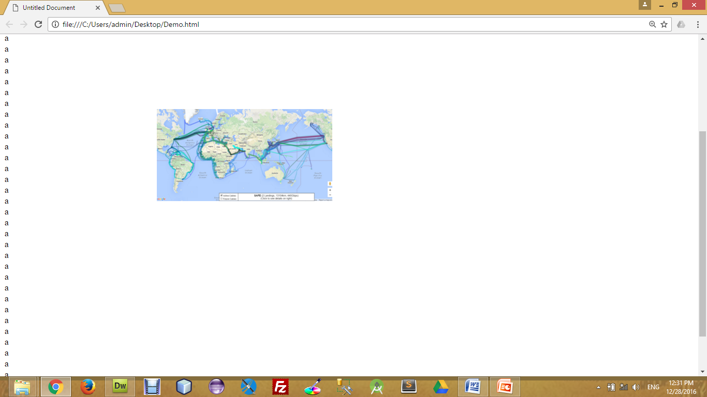
Background Image Positioning
The background-position property sets the starting position of a background image.
test.css
body
{
background-image : url(‘pathToImage.jpg’);
background-repeat : no-repeat;
background-position: 20px 10px;
background-position: 30%30%;
background-position: top center;
}

Slide 47
CSS Font
CSS font properties define the font family, boldness, size, and the style of a text.
Font Color (color)
Font Family (font-family)
Font Size (font-size)
Font Style (font-style)
Font Weight (font-weight)
Font Variant (font-variant)
Property Name

Slide 48
CSS Font (Cont.)
h4{
color : red;
}
Font Color
Set the text-color for different elements
Font Family
The font family of a text is set with the font-family property.
Font Size
The font-size property sets the size of the text.
font-size : 120%
font-size : 10px;
font-size : x-large;
h4{
font-family : sans-serif;
}
h4{
font-size: 120%;
font-size : 10px;
font-size : small;
font-size : smaller;
font-size : x-small;
font-size : xx-small;
font-size : large;
font-size : larger;
font-size : x-large;
font-size : xx-large;
font-size : medium;
}

Slide 49
CSS Font (Cont.)
Font Style
The font-style property is mostly used to specify italic text.
Font Weight
The font-weight property sets how thick or thin characters in text should be displayed.
Font Variant
The font-variant property specifies whether or not a text should be displayed in a small-caps font.
font-variant : small-caps;
h4{
font-style: italic ;
}
h4{
font-weight : 300;
font-weight : bolder;
font-weight : lighter;
}
h4{
font-variant: small-caps;
}

Slide 50
CSS Text Property
While CSS Font covers most of the traditional ways to format your text, CSS Text allows you to control the spacing, decoration, and alignment of your text.
Text Decoration (text-decoration)
Text Indent (text-indent)
Text Align (text-align)
Text Transform (text-transform)
White Space (white-space)
Word Spacing (word-spacing)
Letter Spacing (letter-spacing)
Line Height (line-height)
Property Name

Slide 51
CSS Text Property (Cont.)
Text Decoration
The text-decoration property is used to set or remove decorations from text.
The text-decoration property is mostly used to remove underlines from links for design purposes.
Text Indent
The text-indentation property is used to specify the indentation of the first line of a text.
Text Align
The text-align property is used to set the horizontal alignment of a text.
h4{
text-decoration : line-through;
text-decoration : overline;
text-decoration : underline;
text-decoration : none;
}
h4{
text-indent : 20px;
text-indent : 30%;
}
h4{
text-align : right;
text-align : justify;
text-align : left;
text-align : center;
}

Slide 52
CSS Text Property (Cont.)
Text Transform
The text-transform property is used to specify uppercase and lowercase letters in a text.
White Space
The white-space attribute allows you to prevent text from wrapping until you place a break <br /> into your text.
Word Spacing
With the CSS attribute word-spacing you are able to specify the exact value of the spacing between your words. Word-spacing should be defined with exact values.
h4{
text-transform : capitalize;
text-transform : uppercase;
text-transform : lowercase;
}
h4{
white-space : nowrap;
white-space : normal;
white-space : pre;
}
h4{
word-spacing : 10px;
}

Slide 53
CSS Text Property (Cont.)
Letter Spacing
With the CSS attribute letter-spacing you are able to specify the exact value of the spacing between your letters. Letter-spacing should be defined with exact values.
Line Height
The line-height attribute will set the height of the line in the page.
h4{
letter-spacing : 3px;
}
h4{
line-height : 10px;
}

Slide 54
The Box Model
All HTML elements can be considered as boxes. In CSS, the term "box model" is used when talking about design and layout.
The CSS box model is essentially a box that wraps around HTML elements, and it consists of: margins, borders, padding, and the actual content.
The box model allows us to place a border around elements and space elements in relation to other elements.

Slide 55
The Box Model (Cont)
The image below illustrates the box model:
Margin
Border
Padding
Content

Slide 56
The Box Model (Cont)
margin-top
border-top
padding-top
Content
border-right
padding-left
margin-right
margin-left
padding-right
border-left
padding-bottom
border-bottom
margin-bottom

Slide 57
CSS Padding
The CSS padding properties define the space between the element border and the element content.
The top, right, bottom, and left padding can be changed independently using separate properties.
A shorthand padding property can also be used, to change all padding at once.
h4{
padding : 10px;
}
h4{
padding-top : 10px;
padding-right : 20px;
padding-bottom : 30 px;
padding-left : 40 px;
}
h4{
padding : 10px 20px 30px 40px;
}

Slide 58
CSS Border
The CSS border properties allow you to specify the style and color of an element's border.
Border Style Types
The border-style property specifies what kind of border to display.
Border Width
The border-width property is used to set the width of the border.
Border Color
The border-color property is used to set the color of the border.
Border colors can be any color defined by RGB, hexadecimal, or key terms. Below is an example of each of these types.
The top, right, bottom, and left border can be changed independently using separate properties.
h4{
border : 1px solid red;
}
h4{
border-style : solid;
border-style : dotted;
border-style : double;
}
h4{
border-width : 7px;
}
h4{
border-color : red;
}
h4{
border-top : 1px solid red;
}

Slide 59
CSS Margin
The CSS margin properties define the space around elements
The top, right, bottom, and left margin can be changed independently using separate properties.
A shorthand margin property can also be used, to change all margins at once.
h4{
margin: 10px;
}
h4{
margin -top : 10px;
margin -right : 20px;
margin -bottom : 30 px;
margin -left : 40 px;
}
h4{
margin : 10px 20px 30px 40px;
}

Slide 60
CSS Positioning
Absolute Positioning
With absolute positioning, you define the exact pixel value where the specified HTML element will appear.
The point of origin is the top-left of the browser's viewable area, so be sure you are measuring from that point.
Relative Positioning
Relative positioning changes the position of the HTML element relative to where it normally appears
Fixed Positioning
The element is positioned relative to the browser window, in fixed position, element will be in the same place even we scroll the screen.
Sticky Positioning
An element with position: sticky; is positioned based on the user's scroll position.
A sticky element toggles between relative and fixed, depending on the scroll position.
h1{
position : absolute;
left : 50px;
top : 100px;
}
h1{
position : relative;
left : 50px;
top : 100px;
}
h1{
position : fixed;
top : 50px;
left : 100px;
}
h1{
position : sticky;
top : 0px;
}

Slide 61

CSS Layers
CSS allows you to control which item will appear on top with the use of layers.
In CSS, each element is given a priority.
If there are two overlapping CSS positioned elements, the element with the higher priority will appear on top of the other.
To manually define a priority, set the z-index value. The larger the value, the higher the priority the element will have.
CSS
#division1{
position : absolute;
height : 100px;
width : 100px;
left : 100px;
top : 150px;
background-color : red;
z-index : 5;
}
#division2{
position : absolute;
height : 200px;
width : 200px;
left : 50px;
top : 100px;
background-color : blue;
z-index : 2;
}
HTML
<div id="division1">
</div>
<div id="division2">
</div>

Slide 62
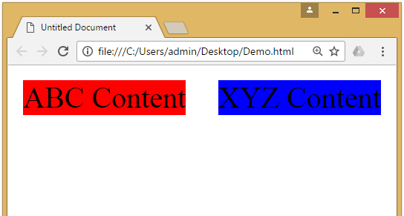
CSS Float Property
The CSS float property defines that an element should be taken out of the normal flow of the document and placed along the left or right side of its containing block.
Text and inline elements will then wrap around this element.
CSS
#division1{
background-color : red;
float : left;
width: 40%;
}
#division2{
background-color : blue;
float : right;
width: 40%;
}
HTML
<div id="division1">
ABC Content
</div>
<div id="division2">
XYZ Content
</div>

Slide 63
Introduction to CSS3
CSS3 is the latest standard for CSS.
CSS3 is completely backwards-compatible with earlier versions of CSS.
CSS3 has been split into "modules". It contains the "old CSS specification" (which has been split into smaller pieces). In addition, new modules are added.
CSS3 Transitions are a presentational effect which allow property changes in CSS values, such as those that may be defined to occur on :hover or :focus, to occur smoothly over a specified duration – rather than happening instantaneously as is the normal behavior.
Transition effects can be applied to a wide variety of CSS properties, including background-color, width, height, opacity, and many more.

Slide 64
Introduction to CSS3 (Cont)
Some of the most important CSS3 modules are:
CSS Animations and Transitions
Calculating Values With calc()
Advanced Selectors
Generated Content and Counters
Gradients
Webfonts
Box Sizing
Border Images
Media Queries
Multiple Backgrounds
CSS Columns
Courtesy : http://tutorialzine.com/2013/10/12-awesome-css3-features-you-can-finally-use/

Slide 65
Animations
CSS animations make it possible to animate transitions from one CSS style configuration to another.
Animations consist of two components,
a style describing the CSS animation
a set of keyframes that indicate the start and end states of the animation’s style, as well as possible intermediate waypoints.
There are three key advantages to CSS animations over traditional script-driven animation techniques:
They’re easy to use for simple animations; you can create them without even having to know JavaScript.
The animations run well, even under moderate system load. Simple animations can often perform poorly in JavaScript. The rendering engine can use frame-skipping and other techniques to keep the performance as smooth as possible.
Letting the browser control the animation sequence lets the browser optimize performance and efficiency by, for example, reducing the update frequency of animations running in tabs that aren't currently visible.

Slide 66
Configuring the animation
To create a CSS animation sequence, you style the element you want to animate with the animation property or its sub-properties. This lets you configure the timing, duration, and other details of how the animation sequence should progress.
Note: This does not configure the actual appearance of the animation, which is done using the @keyframes
The sub-properties of the animation property are:
animation-name : Specifies the name of the @keyframes at-rule describing the animation’s keyframes.
animation-duration : Configures the length of time that an animation should take to complete one cycle.
animation-timing-function : Configures the timing of the animation; that is, how the animation transitions through keyframes, by establishing acceleration curves. (linear, ease, ease-in, ease-out etc…)
animation-delay : Configures the delay between the time the element is loaded and the beginning of the animation sequence.
animation-iteration-count : Configures the number of times the animation should repeat; you can specify infinite to repeat the animation indefinitely.
animation-direction : Configures whether or not the animation should alternate direction on each run through the sequence or reset to the start point and repeat itself. (normal, reverse, alternate etc…)
animation-fill-mode : Configures what values are applied by the animation before and after it is executing.
animation-play-state : Lets you pause and resume the animation sequence.

Slide 67
Defining the animation sequence using keyframes
Once you’ve configured the animation’s timing, you need to define the appearance of the animation. This is done by establishing two or more keyframes using the @keyframes at-rule.
Each keyframe describes how the animated element should render at a given time during the animation sequence.
Example
CSS
p {
animation-duration: 3s;
animation-name: slidein;
}
@keyframes slidein {
from { /* or 0% */
margin-left: 100%;
width: 300%;
} to { /* or 100% */
margin-left: 0%;
width: 100%;
}
}
HTML
<p>
Hello World
</p>

Slide 68
Specifying Intermediate steps
We can specify intermediate steps using percentage of time in @keyframes, similar to the example given below.
HTML
<p>
Hello World
</p>
CSS
p {
animation-duration: 4s;
animation-name: changeColors;
}
@keyframes changeColors {
0% {background-color: yellow;}
25% {background-color: blue;}
50% {background-color: green;}
100% {background-color: red;}
}

Slide 69
Tooltip
A tooltip is often used to specify extra information about something when the user moves the mouse pointer over an element.
HTML
<div class="tooltip">Hover here to see tooltip
<span class="tooltiptext">Tooltip text</span>
</div>
CSS
.tooltip .tooltiptext {
visibility: hidden;
width: 120px;
background-color: black;
color: #fff;
text-align: center;
border-radius: 6px;
padding: 5px 0;
position: absolute;
z-index: 1;
}
.tooltip:hover .tooltiptext {
visibility: visible;
}
CSS
.tooltip {
position: relative;
display: inline-block;
border-bottom: 1px dotted black;
}

Slide 70
Style Images
We can use many properties with Images like,
opacity
border-radius
margin-left, margin-right to be auto and display to be block (to make it aligned center)
max-width to be 100% and height to be auto (to make it responsive)
filter
etc…

Slide 71
CSS Variables / Custom Properties
Custom properties (sometimes referred to as CSS variables or cascading variables) are entities defined by CSS authors that contain specific values to be reused throughout a document.
Advantages of using CSS variables are:
makes the code easier to read (more understandable)
makes it much easier to change.
CSS variables can have a global or local scope.
Global variables can be accessed/used through the entire document.
To create a variable with global scope, declare it inside the :root selector. The :root selector matches the document's root element.
local variables can be used only inside the selector where it is declared.
To create a variable with local scope, declare it inside the selector that is going to use it.
We can use var() function in order to access the variable set in the css.

Slide 72
CSS Variables (Example)
HTML
<p>
Hello World
</p>
<div>
How are you?
</div>
CSS
:root{
--myFavColor : orange;
--myNextFacColor : green;
}
p{
background-color: var(--myFavColor);
color: var(--myNextFacColor);
}
div{
background-color: var(--myNextFacColor);
color: var(--myFavColor);
}

Slide 73
Media Queries
Media queries are a way to target browser by certain characteristics, features, and user preferences, then apply styles or run other code based on those things.
Perhaps the most common media queries in the world are those that target particular viewport ranges and apply custom styles, which is the whole idea of responsive design.
General syntax for the media queries in CSS is,
It consists of:
A media type, which tells the browser what kind of media this code is for (e.g. print, screen etc…).
A media feature, which is a rule, or test that must be passed for the contained CSS to be applied.
A set of CSS rules that will be applied if the test passes and the media type is correct.
Syntax
@media [media-type] ([media-feature]) {
/* Styles! */
}

Slide 74
Media Query (Cont.)
Media Types:
all
print
screen
speech
Media Features:
width & height
min-width, min-height, max-width & max-height
orientation
The viewport meta tag:
<meta name="viewport" content="width=device-width, initial-scale=1.0">
This is needed because by default, most mobile browsers lie about their viewport width.
Non-responsive sites commonly look really bad when rendered in a narrow viewport, so mobile browsers usually render the site with a viewport width wider than the real device width by default (usually 960 pixels), and then shrink the rendered result so that it fits in the display.

Slide 75
Media Query (Example)
CSS
#div1{
background-color: red;
width: 50%;
float: left;
}
#div2{
background-color: yellow;
width: 50%;
float: left;
} @media (max-width: 600px){
#div1{
width: 100%;
}
#div2{
width: 100%;
}
}
HTML
<div id="div1">
Hello
</div>
<div id="div2">
World
</div>
Note: you have to add viewport meta tag in the head section
<meta name="viewport" content=
"width=device-width, initial-scale=1.0">

Slide 76
Media Query (cont.)
We can also use and/or logic in media query, for example
We can use and as a separator if we want two condition to satisfy before applying the CSS.
We can use , (comma) as a separator if we want anyone of the condition to satisfy before applying the CSS.
CSS
@media screen and (min-width: 600px) and (max-width: 900px) {
body {
color: blue;
}
}
CSS
@media (min-width: 600px), (orientation: landscape) {
body {
color: blue;
}
}

Slide 77
Wild Card Selectors
Wildcard selector is used to select multiple elements simultaneously.
It selects similar type of class name or attribute and apply CSS property.
Some of the wild card selector are,
[attribute*=”str”] Selector ( e.g. [class*="str"] )
It will select all the elements with the given attribute containing the str.
[attribute^=”str”] Selector ( e.g. [class^="str"] )
It will select all the elements with the given attribute starts with the str.
[attribute$=”str”] Selector ( e.g. [class$="str"] )
It will select all the elements with the given attribute ends with the str.

Slide 78
Gradients
CSS gradients let you display smooth transitions between two or more specified colors.
CSS defines two types of gradients:
Linear Gradients (goes down/up/left/right/diagonally)
To create a linear gradient you must define at least two color stops.
Color stops are the colors you want to render smooth transitions among.
You can also set a starting point and a direction (or an angle) along with the gradient effect.
Radial Gradients (defined by their center)
The radial-gradient() function sets a radial gradient as the background image.
A radial gradient is defined by its center.
To create a radial gradient you must define at least two color stops.

Slide 79
Linear Gradients
To create a linear gradient you must define at least two color stops.
Color stops are the colors you want to render smooth transitions among.
You can also set a starting point and a direction (or an angle) along with the gradient effect.
direction:
to bottom
to top
to right
to left
to bottom left
180deg
Etc…
Syntax
background-image: linear-gradient(direction, color-stop1, color-stop2, ...);

Slide 80

Linear Gradients (Example)
Example:
Output:
CSS
background-image: linear-gradient(red, yellow);

Slide 81
Radial Gradients
To create a linear gradient you must define at least two color stops.
Color stops are the colors you want to render smooth transitions among.
You can also set a starting point and a direction (or an angle) along with the gradient effect.
shape:
Ellipse (defalt)
Circle
size:
farthest-corner (default)
closest-corner
farthest-side
closest-side
position:
Center (default)
Etc…
Syntax
background-image: radial-gradient(shape size at position, start-color, ..., last-color);

Slide 82

Radial Gradients (Example)
Example:
Output:
CSS
background-image: radial-gradient(red, green, yellow);

Slide 83
Pseudo Classes
A pseudo-class is used to define a special state of an element.
For example, it can be used to:
Style an element when a user mouse over it
Style visited and unvisited links differently
Style an element when it gets focus
Some important pseudo classes are:
active
disabled
first-child
nth-child()
focus
hover
visited
Syntax
selector:pseudo-class { property: value; }

Slide 84
Pseudo Elements
A CSS pseudo-element is used to style specified parts of an element.
For example, it can be used to:
Style the first letter, or line, of an element
Insert content before, or after, the content of an element
pseudo elements are,
after
before
first-letter
first-line
selection
Syntax
selector::pseudo-element { property: value; }

Slide 85
Bootstrap
Bootstrap is Free front-end framework made of HTML, CSS and JavaScript Plugins (optional) for developing Responsive Websites.
Responsive websites means websites which Automatically Adjust themselves to look good on all devices like mobile, desktop etc…
Why to Use Bootstrap?
Easy to use
Anybody with just basic knowledge of HTML and CSS can start using Bootstrap
Responsive features
It's responsive CSS adjusts to phones, tablets, and desktops
Mobile-first approach
Mobile-first styles are part of the core framework
Browser compatibility
Compatible with all modern browsers (Chrome, Firefox, Internet Explorer, Safari, and Opera)
Free

Slide 86
Internet Programming (IP)
Admas Abtew
Faculty of Computing and Informatics
Admas.abtew@ju.edu.et
0912499102

